Slide 1

Workshop
Sarah Stolle
23 August 2018

Slide 2
Purpose of R shiny app
Explore
Inform
Data
Visualize
Interact

Slide 3

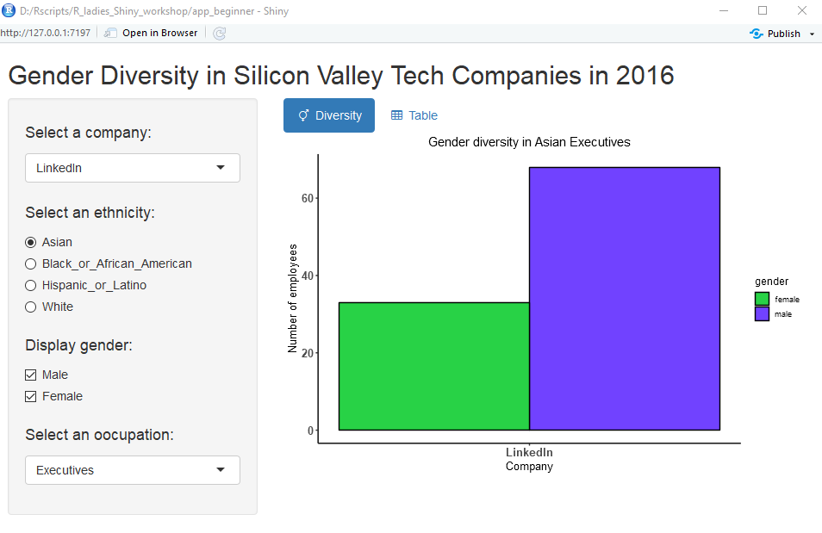


Shiny apps require a PC to run R

Slide 4


Basic structure of an app
User interface (ui.r)
Generates input
Interactive Shiny app
Server.R
Generates output
Notes:
UI = code what people should see (place holders for buttons, graphs etc)
Server = code what should happen upon click, calculate data, format data, make graph, etc
Shiny generates HTML for you!

Slide 5
Minimal app template
library(shiny)
ui <- fluidPage()
server <- function(input, output) {}
shinyApp(ui = ui, server = server)

Slide 6
Build your app around
Inputs and Outputs

Slide 7
Ui.R (User interface)
Define layout
Position placeholders
User input elements:
Buttons
Selection boxes
Output elements:
Plots
Tables ...
Title
Sidebar panel
input
Main panel
output

Slide 8
Ui.R (User interface)
ui <- fluidPage(
titlePanel(„Title text“),
sidebarLayout(
sidebarPanel(
# Input*() functions
),
mainPanel(
# Output*() function
)
)
Title
Sidebar panel
input
Main panel
output

Slide 9
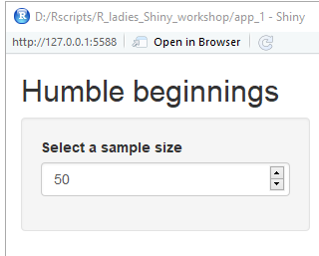
Creating an input
library(shiny)
ui <- fluidPage(
sidebarLayout(
titlePanel(“Humble beginnings”),
sidebarPanel(
numericInput(
inputId = “num",
label = “Select a sample size”,
value = 50)
)
)
)
server <- function(input, output) {}
shinyApp(server= server, ui = ui)

Slide 10
Input function syntax
numericInput(
inputId = “num",
label = "Select a sample size:”,
value = 50
Important! explained later
Title of input
default value

Slide 11
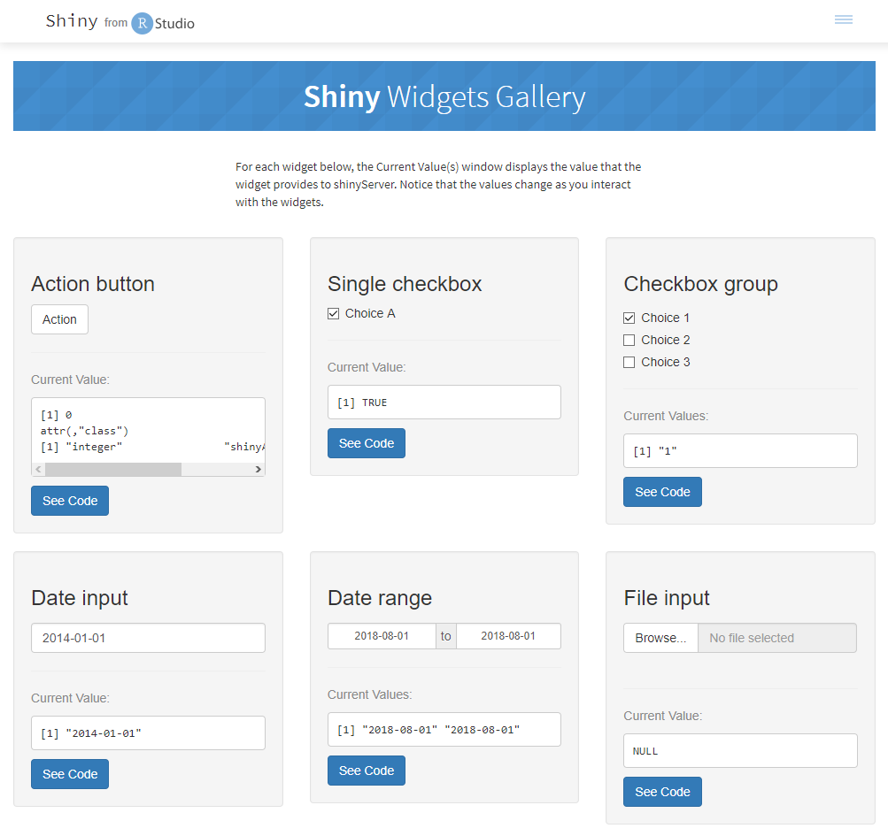
Widgets and buttons
checkboxInput()
actionButton()
checkboxGroupInput()
dateRangeInput()
visit
dateInput()
fileInput()

Slide 12
Overview input functions
Function | creates
actionButton() | A button
checkboxInput() | A single check box
checkboxGroupInput() | Numerous check boxes
dateInput() | A date
dateRangeInput() | A range of dates (from – to)
fileInput() | Browse location of file
numericInput() | An integer
radioButtons() | A number of radio buttons
selectInput() | Select an option
sliderInput() | Create a slider for numeric input
textInput() | User can type text

Slide 13

Shiny Setup
Download work material
Open R studio
install.packages():
Shiny
ggplot2

Slide 14
Practical 1
Run app_1/app_1.R
Change the title
Switch the location of the sidebarPanel
Add a little descriptive text to the sidebarPanel
5 min

Slide 15
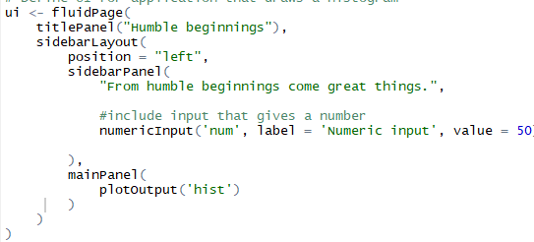
Solution 1: Change title
1

Slide 16
Solution 1: location of sidebarPanel
Left or right
2

Slide 17
Solution 1: Explanatory text
Don’t forget comma
3

Slide 18
Outputs

Slide 19
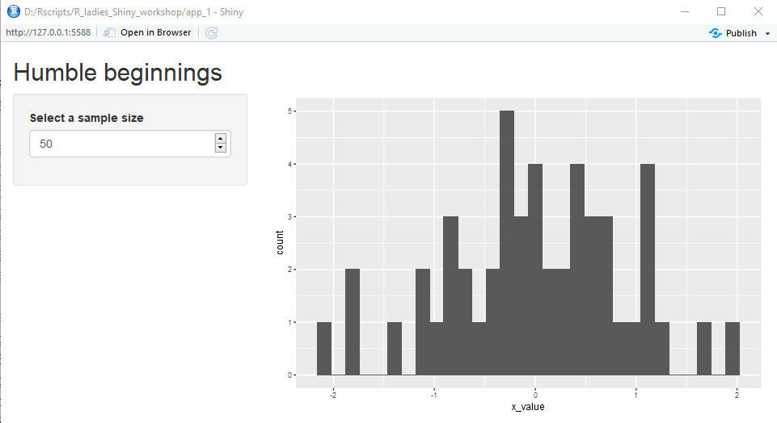
Output functions
plotOutput(“hist”)
Output Id
Type of output

Slide 20
Creating an output
library(shiny)
ui <- fluidPage(
sidebarLayout(
titlePanel(“Humble beginnings”),
sidebarPanel(
numericInput(
inputId = “num",
label = “Select a sample size”,
value = 50),
),
mainPanel(
plotOutput(“output_id”)
)
)
)
server <- function(input, output) {}
shinyApp(server= server, ui = ui)
plotOutput() creates a placeholder for an R plot object
Make plot in server function

Slide 21
Overview output functions
Function | Inserts
dataTableOutput() | An interactive table
htmlOutput() | Raw HTML
imageOutput() | Image
plotOutput() | Plot
tableOutput() | Table
textOutput() | Text
uiOutput() | Shiny ui element
verbatimTextOutput() | text

Slide 22
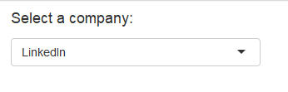


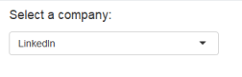
Recap Ui.R
library(shiny)
ui <- fluidPage()
server <- function(input, output) {}
shinyApp(ui = ui, server = server)
Start with the template
Add elements to fluidPage()
Reactive inputs with input()
Reactive outputs with output()
Assemble app with server function
ui <- fluidPage(
# Input() functions,
# Output() function
)

Slide 23
Server

Slide 24
Server.R
Load data
Process data
Calculate output (plots, tables, etc)
Connect input with output

Slide 25
3 rules to write a server function
server <- function(input, output) {
}

Slide 26
1 Save objects to display to output$
server <- function(input, output) {
output$hist <- #code
}

Slide 27
1 Save objects to display to output$
plotOutput(“hist”)
output$hist

Slide 28
2 Build objects with render*()
server <- function(input, output) {
output$hist <- renderPlot({
dataset <- data.frame("x_value" = rnorm(input$num))
plt <- ggplot(dataset, aes(x_value)) +
geom_histogram()
plt
})
}

Slide 29
3 Connect input with output
server <- function(input, output) {
output$hist <- renderPlot({
dataset <- data.frame("x_value" = rnorm(input$num))
plt <- ggplot(dataset, aes(x_value)) +
geom_histogram()
plt
})
}

Slide 30
3 Connect input with output
selectInput(inputId = “num”)
input$num

Slide 31
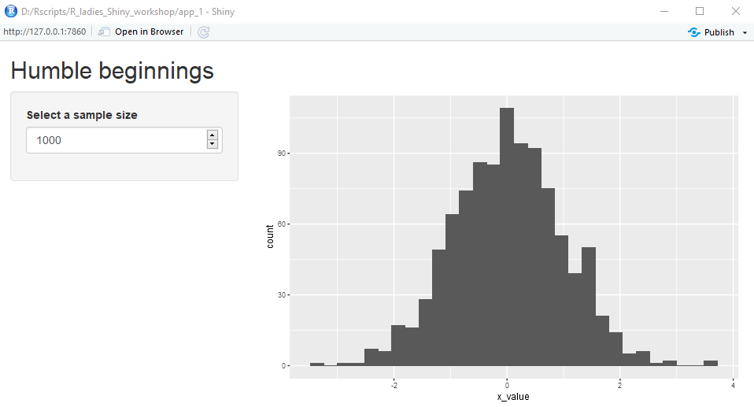
Reactive values
Automatically update output when input changes
1000
50

Slide 32
Overview render functions
Function | Creates
renderDataTable() | An interactive table
renderImage() | An image
renderPlot() | A plot
renderPrint() | A code block of printed output
renderTable() | A table
renderText() | A character string
renderUI() | A shiny UI element

Slide 33
Recap Server.R
Follow 3 rules to make server output
Save output to output$
Build output with render*()
Access input values with input$
output$hist <-
renderPlot({
plot_histogram(df)
})
input$num

Slide 34
Practical 2
Include slider input for sample size
Include plot output for the histogram
Folder -> app_2
7 - 10 min

Slide 35
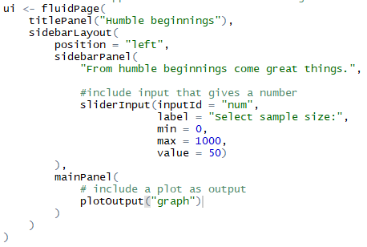
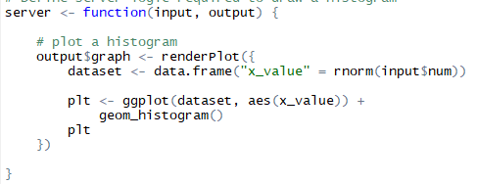
Solution 2: Add slider input
1

Slide 36
Solution 2: Add plot output
2

Slide 37
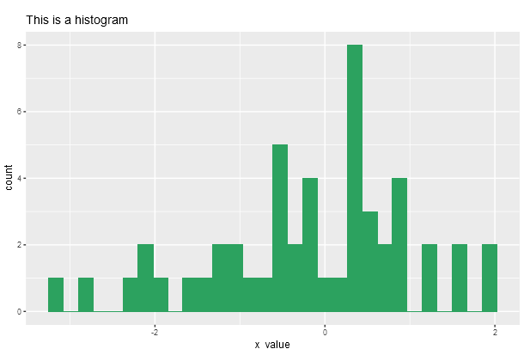
Practical 3
Open app_3.R
Include text input for a plot title
Include radio buttons to change color of plot
10 min

Slide 38
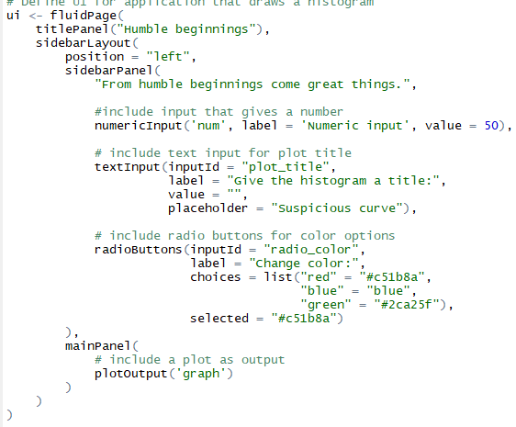
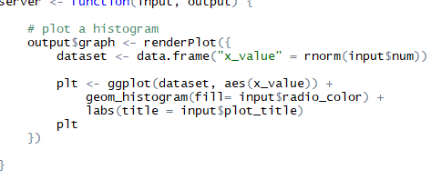
Solution 3: add text input
1

Slide 39
Solution 3: add radio button
2

Slide 40
Two-file app
# ui.R
library(shiny)
ui <- fluidPage(
sidebarLayout(
titlePanel(“Humble beginnings”),
sidebarPanel(
numericInput(
inputId = “num",
label = “Select a sample size”,
value = 50),
plotOutput(“hist”)
)))
library(shiny)
ui <- fluidPage(
sidebarLayout(
titlePanel(“Humble beginnings”),
sidebarPanel(
numericInput(
inputId = “num",
label = “Select a sample size”,
value = 50),
plotOutput(“hist”)
)))
server <- function(input, output){
output$hist <- renderPlot({
dataset <- data.frame("x_value" = rnorm(input$num))
plt <- ggplot(dataset, aes(x_value)) +
geom_histogram()
plt
})}
shinyApp(server= server, ui = ui)
# server.R
library(shiny)
server <- function(input, output){
output$hist <- renderPlot({
dataset <- data.frame("x_value" = rnorm(input$num))
plt <- ggplot(dataset, aes(x_value)) +
geom_histogram()
plt
})}

Slide 41
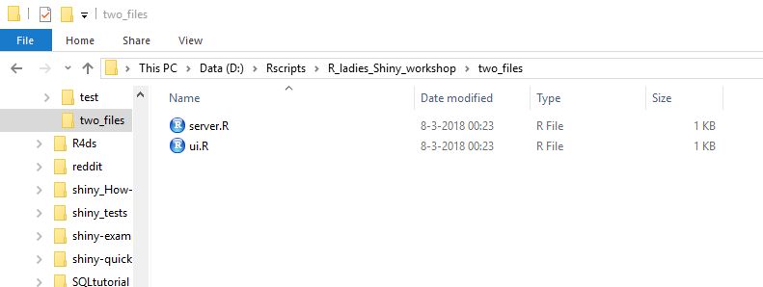
Two-file app
One directory with two files
ui.R server.R

Slide 42
BREAK 5 min

Slide 43
Resources

Slide 44
Tips & Tricks
Think what you want to show
Start with app layout (ui)
Create your app line by line to minimize debugging
Preprocess data prior to Rshiny

Slide 45
Make it fancy
Shiny gallery
Change layout theme: shinythemes
Add icons to e.g. TabPanels via font-awesome
Select colors:
RColorBrewer by Cythia Brewer
Viz-palette by Susie Lu & Elijah Meeks

Slide 46
Share your App
i.e. deploy your app
Personal shinyServer
http://www.shinyapps.io

Slide 47
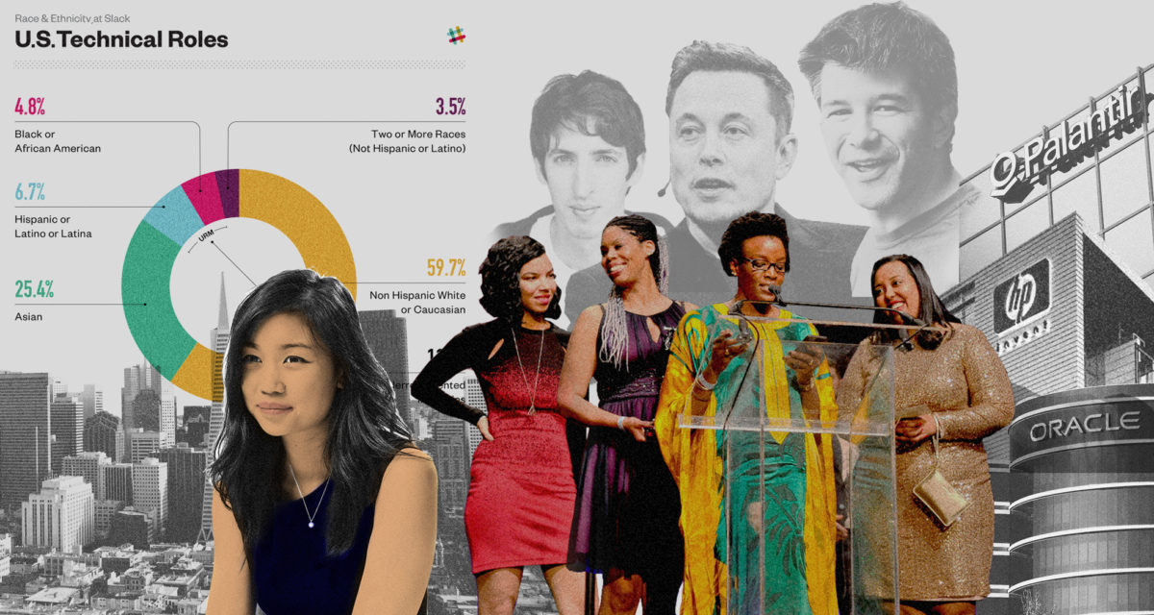
Dataset: Gender distribution in Silicon Valley Tech firms 2016
Gender distribution in
23 companies, further split into
7 ethnicities and
10 job categories

Slide 48
Practical 4
Create your own two-file application using the gender diversity dataset
--> Folder app_4
15 min

Slide 50
Acknowledgements
Presentation based on:
How to start with Shiny - Part 1, by R Studio
Get started with Shiny, by R Studio
Personal experience
Gender diversity data from Reveal

